Slide 1
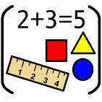
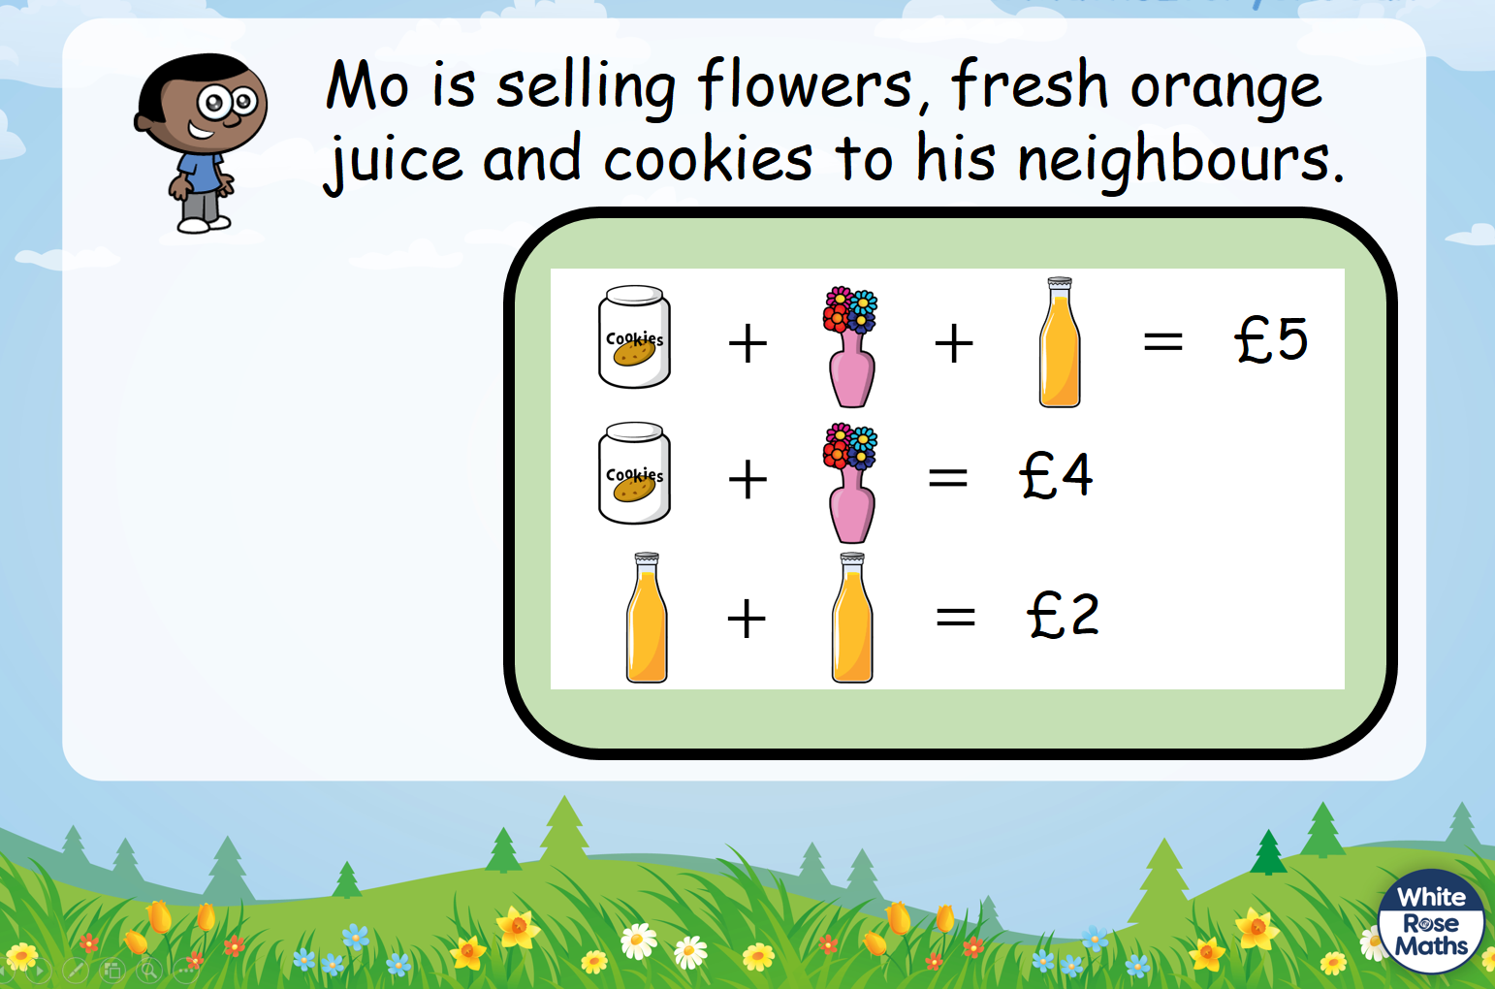
Maths Autumn Challenges
What is the value of the cookies, flowers and the orange juice?

